Slide 1
Image Classification Project

Slide 2
Link Github
https://github.com/yousefmary/Project-Full.git

Slide 3
Module
Image calssification
from pandas import read_csv
from pandas.plotting import scatter_matrix
from matplotlib import pyplot
from sklearn.model_selection import train_test_split
from sklearn.model_selection import KFold
from sklearn.model_selection import cross_val_score
from sklearn.metrics import classification_report
from sklearn.metrics import confusion_matrix
from sklearn.metrics import accuracy_score
from sklearn.linear_model import LogisticRegression
from sklearn.tree import DecisionTreeClassifier
from sklearn.neighbors import KNeighborsClassifier
from sklearn.discriminant_analysis import LinearDiscriminantAnalysis
from sklearn.naive_bayes import GaussianNB
from sklearn.svm import SVC
import pandas as pd
from pandas import set_option
import seaborn as sns
%matplotlib inline
names = ['sepal-length', 'sepal-width', 'petal-length', 'petal-width', 'class']
#pd.set_option('display.width', 100)
dataset = pd.read_csv("/content/iris.csv",names=names)
dataset.describe()

Slide 4
__
print(dataset.shape)
print(dataset.head(20))
print(dataset.groupby('class').size())

Slide 5
__
# histograms
dataset.hist()
pyplot.show()

Slide 6
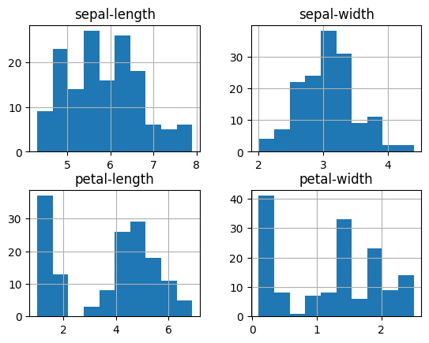

Slide 7
__
from pandas.plotting import scatter_matrix
import matplotlib.pyplot as plt
%matplotlib inline
import seaborn as sns
df_plot = dataset.iloc[:, 0:5]
sns.pairplot(df_plot, diag_kind='kde')

Slide 8
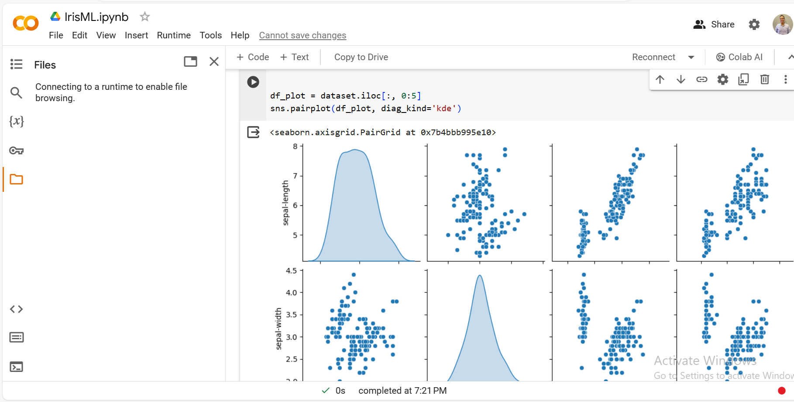
__

Slide 9
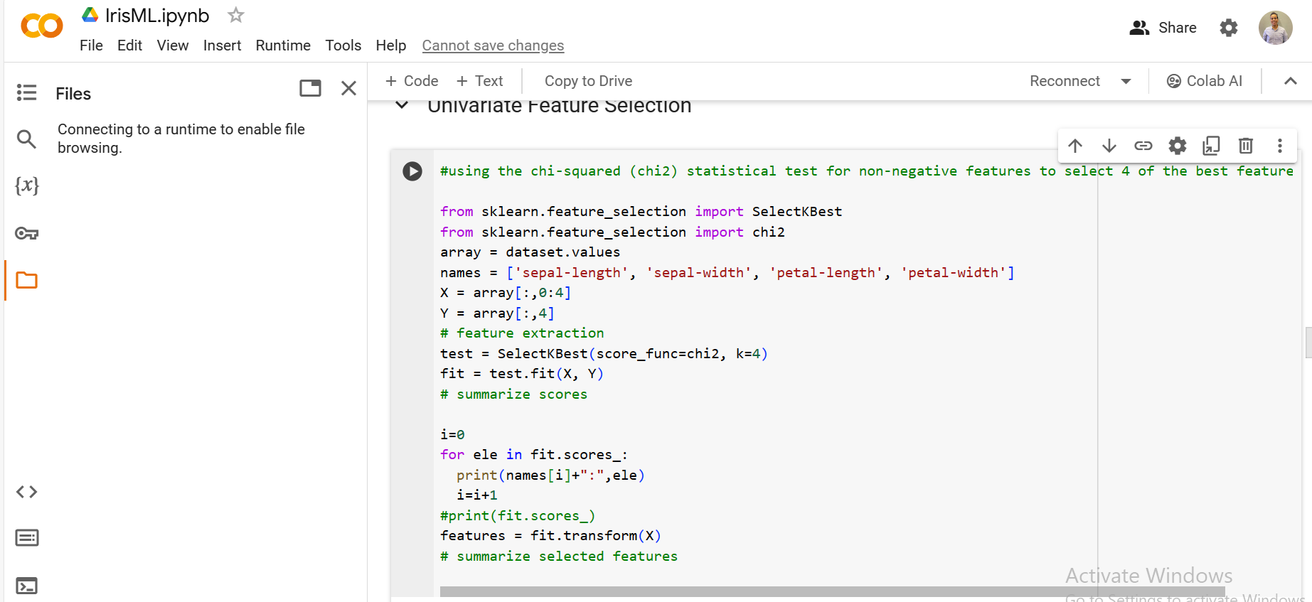

Slide 10
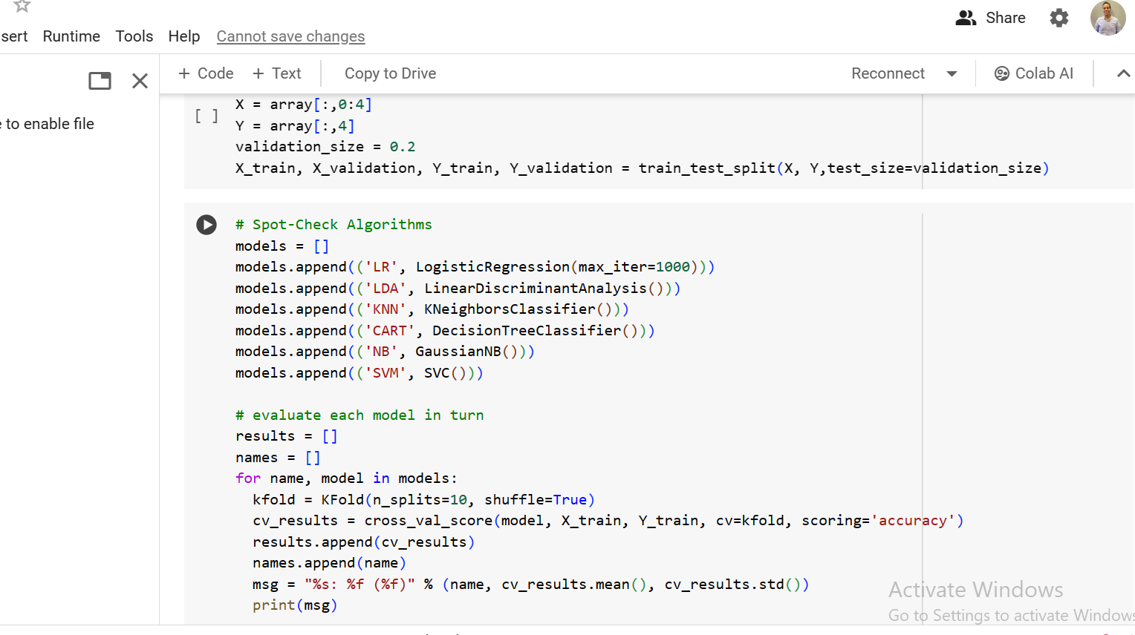
__

Slide 11
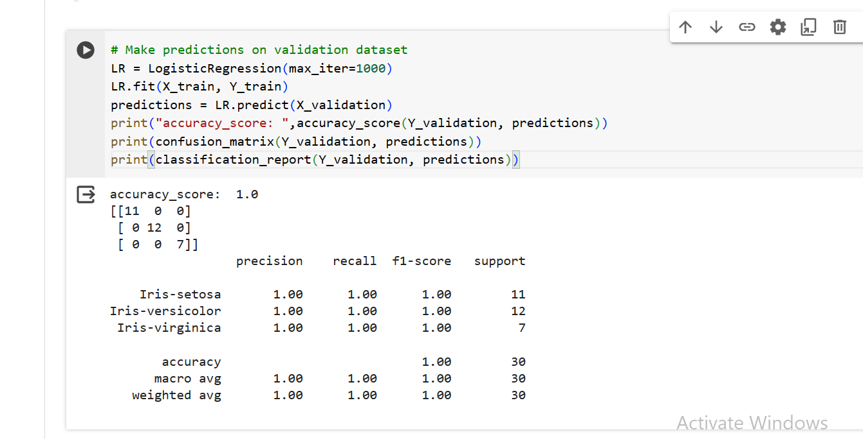
__

Slide 12
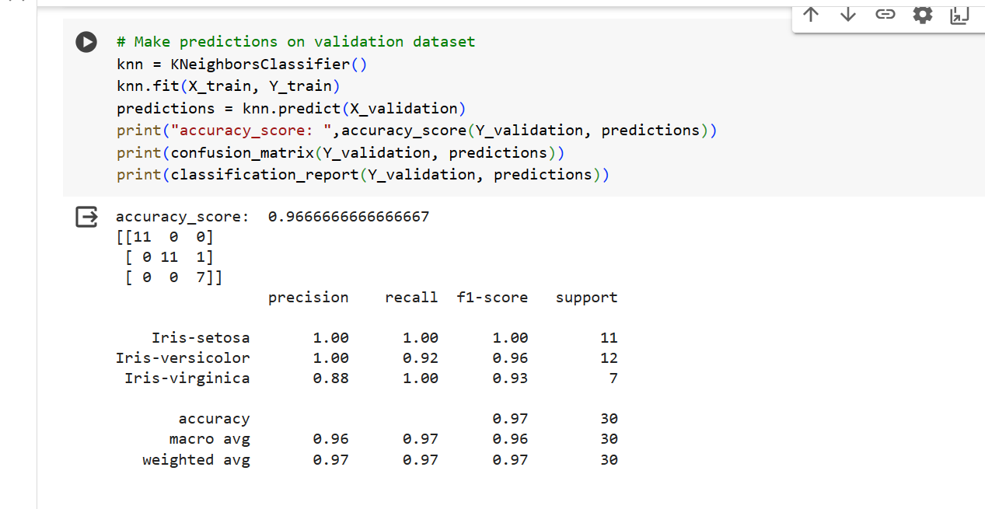
__

Slide 13
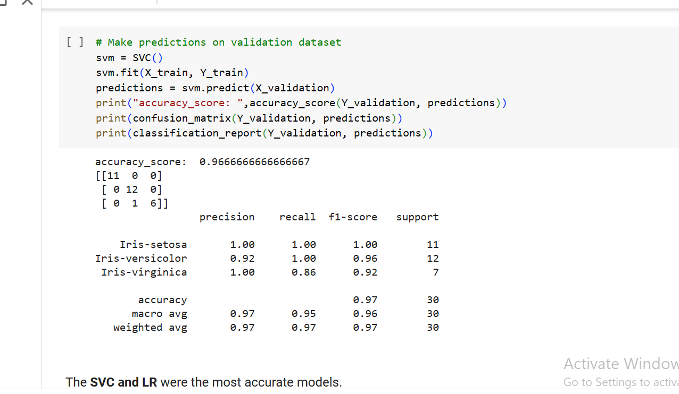
__

Slide 14
END
Thank you eng Nahed for the help in AI training

